Slide 1

Digital Portfolio
STUDENT NAME:R.SUNDARAJAN
REGISTER NO AND NMID: 222402599 AND asunm161222402599
DEPARTMENT: COMPUTER SCIENCE AND DATA SCIENCE
COLLEGE: PRINCE SHRI VENKATESWARA ARTS AND SCIENCE COLLEGE
1
Notes:
1

Slide 2

PROJECT TITLE
"GRADUATE PORTFOLIO WEBSITE"
2

Slide 3



AGENDA
Problem Statement
Project Overview
End Users
Tools and Technologies
Portfolio design and Layout
Features and Functionality
Results and Screenshots
Conclusion
Github Link
3/21/2024 Annual Review
3

Slide 4

PROBLEM STATEMENT
1.Students and job seekers often rely only on resumes to showcase skills.Traditional resumes lack interactivity and creativity.Recruiters find it hard to assess true potential.A digital portfolio can bridge this gap effectively.
4

Slide 5

PROJECT OVERVIEW
Basic PortfolioThis project is a simple personal website about me. It includes sections like About Me, Education, Hobbies, Skills, and Contact with my profile image. The goal is to give a neat introduction to my academic journey.
5

Slide 6

WHO ARE THE END USERS?
1.The end users of my digital portfolio are recruiters and hiring managers who can easily access my profile, skills, and achievements to evaluate me for internships or job opportunities.
2.My digital portfolio is mainly intended for college faculty and mentors, who can review my academic progress, projects, and skills to guide me in my career path.
6

Slide 7

TOOLS AND TECHNIQUES
1.HTML → Used to create the structure of the portfolio (headings, paragraphs, sections).
CSS → Used to add design, colors, and styling.
GitHub Pages → Used to host the portfolio online and share it easily.
2.HTML → For writing the content such as About Me, Education, Skills, and Hobbies.
CSS → For formatting text, setting background colors, and styling images.
Web Browser → To test and view the portfolio while developing.
GitHub → To upload and make the portfolio publicly available.
7

Slide 8
POTFOLIO DESIGN AND LAYOUT
1.Home → A welcome message with my name and profile image.
About Me → A short paragraph about myself.
Skills → A simple bullet or numbered list of my skills.
Education → Details in table format or plain text (School, College, Year).
Hobbies → A simple list of hobbies.
Contact → My phone number, email, and address in plain text.
Responsive → On mobile, everything stacks in a single column.
8

Slide 9
FEATURES AND FUNCTIONALITY
Set 1 Navigation bar with smooth scrolling – helps to move across sections easily.Project showcase with details – highlights my academic and personal works.Interactive hover effects – makes the portfolio engaging to explore.Responsive design – adjusts neatly on all devices.Organized layout – keeps sections clear and simple.

Slide 10
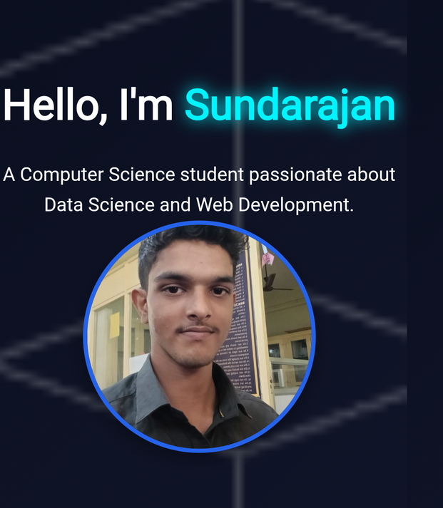
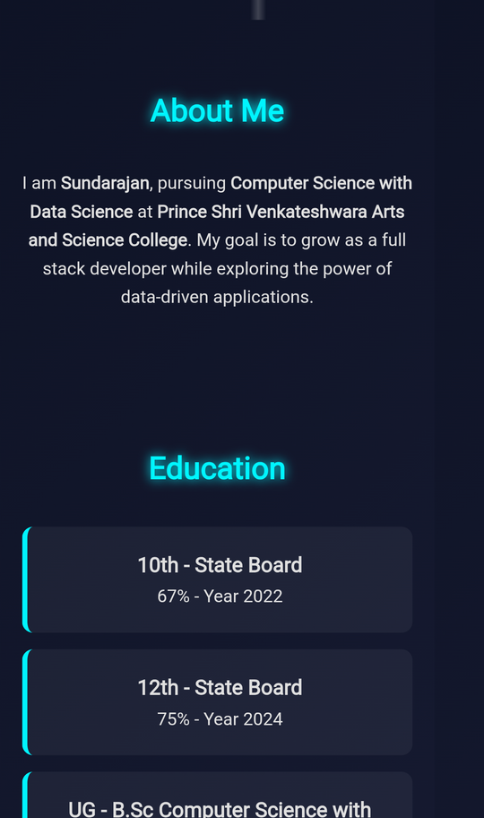

RESULTS AND SCREENSHOTS
3/21/2024 Annual Review
10

Slide 11
CONCLUSION
1. The portfolio shows my background and interests.Sections are arranged in a simple order.Skills and education are clearly mentioned.It is user-friendly and responsive.This is a useful step for my future career.
2. My portfolio is an online representation of me.It covers my About, Education, Skills, and Hobbies.The design is simple, clean, and readable.It can be accessed anytime through a browser.This project improved my basic web development knowledge.
11

